Slide 1


Slide 2



Slide 3

Skills which help us to interact with others and manage our relationships.
Social skills, soft skills, people skills etc.

Slide 4

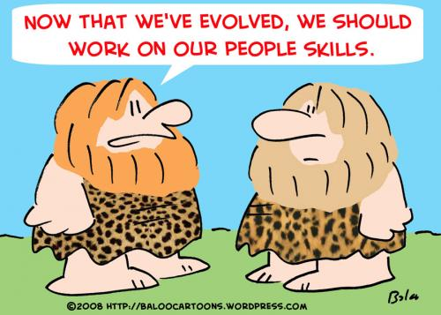

Slide 5

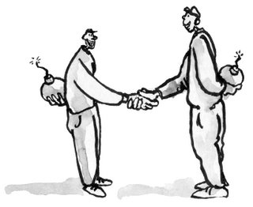

Slide 6
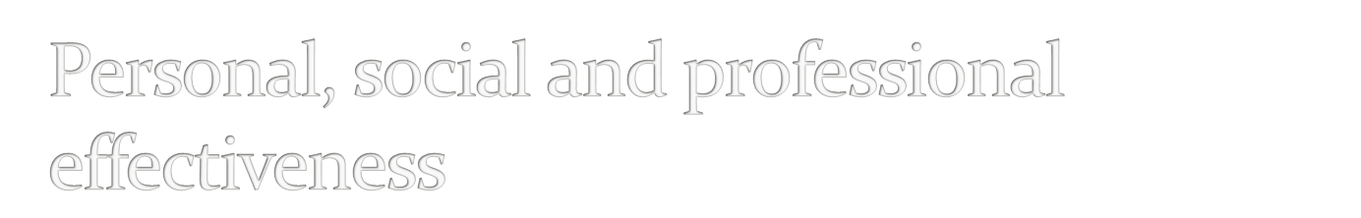
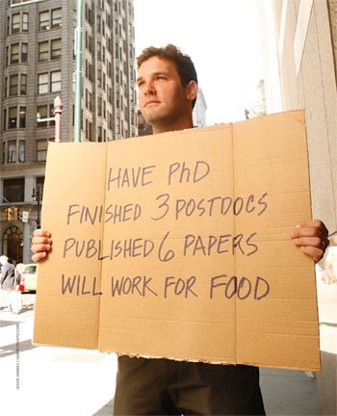

Slide 7



Slide 8
Building trust
Communication skills
Networking skills
Assertiveness
Understanding others
Negotiation skills
Handling conflicts
Etc.,

Slide 9

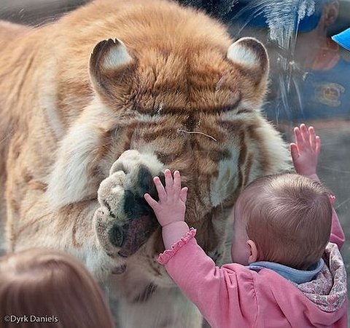

Slide 10

Depend on positively
Trusting involves “risk-taking”
Becoming trustworthy involves effort
Being trusted is a power and responsibility
Trustworthiness is a virtue and building trust is a skill.
If you don’t trust yourself others wont trust you.

Slide 11

Honesty is the base
Be open and communicate
Be reliable
Trust is mutual
Ensure confidentiality
Be self-aware
Accept others limitations
Be assertive

Slide 12



Slide 13



Slide 14

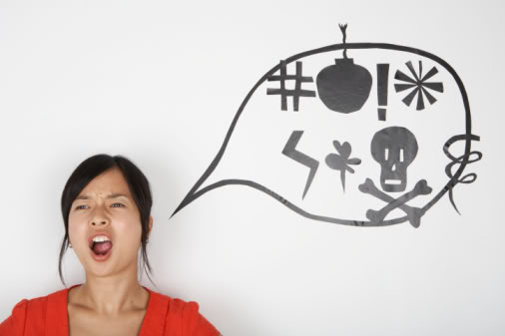

Slide 15

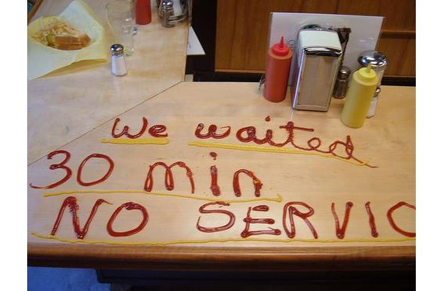

Slide 16

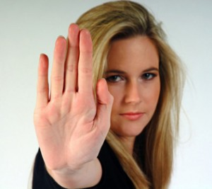

Slide 17

Being yourself … being honest, being caring and above all being fair. Fair to your self — being authentic to your beliefs while maintaining an attitude of care for others. Clearly stating your case without being selfish, vindictive or sarcastic.

Slide 18

Fear
  Of Rejection
  Of being taken for granted
  Of being vulnerable
  Of being humiliated
  Of embarrassment
Insecurity

Slide 19

Dominating
Judgmental
Ridiculing
Making others defensive

Slide 20

Direct statement of wants and feeling
  I want to….., I want you to……
  I would appreciate if you can……
  I feel……
  Mixed feelings statements
Empathetic assertion
Saying NO
Confrontations
  Handling others discrepancies
  Defusing others defensiveness
Managing criticisms and putdowns

Slide 21

Self-understanding
  Be patient and think before you respond
  Introspect
Self-acceptance
Self-esteem
Respect and be empathetic towards others
Observe and Practice

Slide 22

http://www.youtube.com/watch?v=14ifDjDS2mI

Slide 23



Slide 24
Speaking skills
Listening skills
Giving and receiving feedback

Slide 25

Content (What?)
Presentation (How?)
Intention/motivation (Why?)

Slide 26

Plan and prepare
Understand the purpose of the communication
Understand the audience
Don’t use jargons
Be precise
Motivate the audience
Be enthusiastic
Seek feedback
Summarize

Slide 27
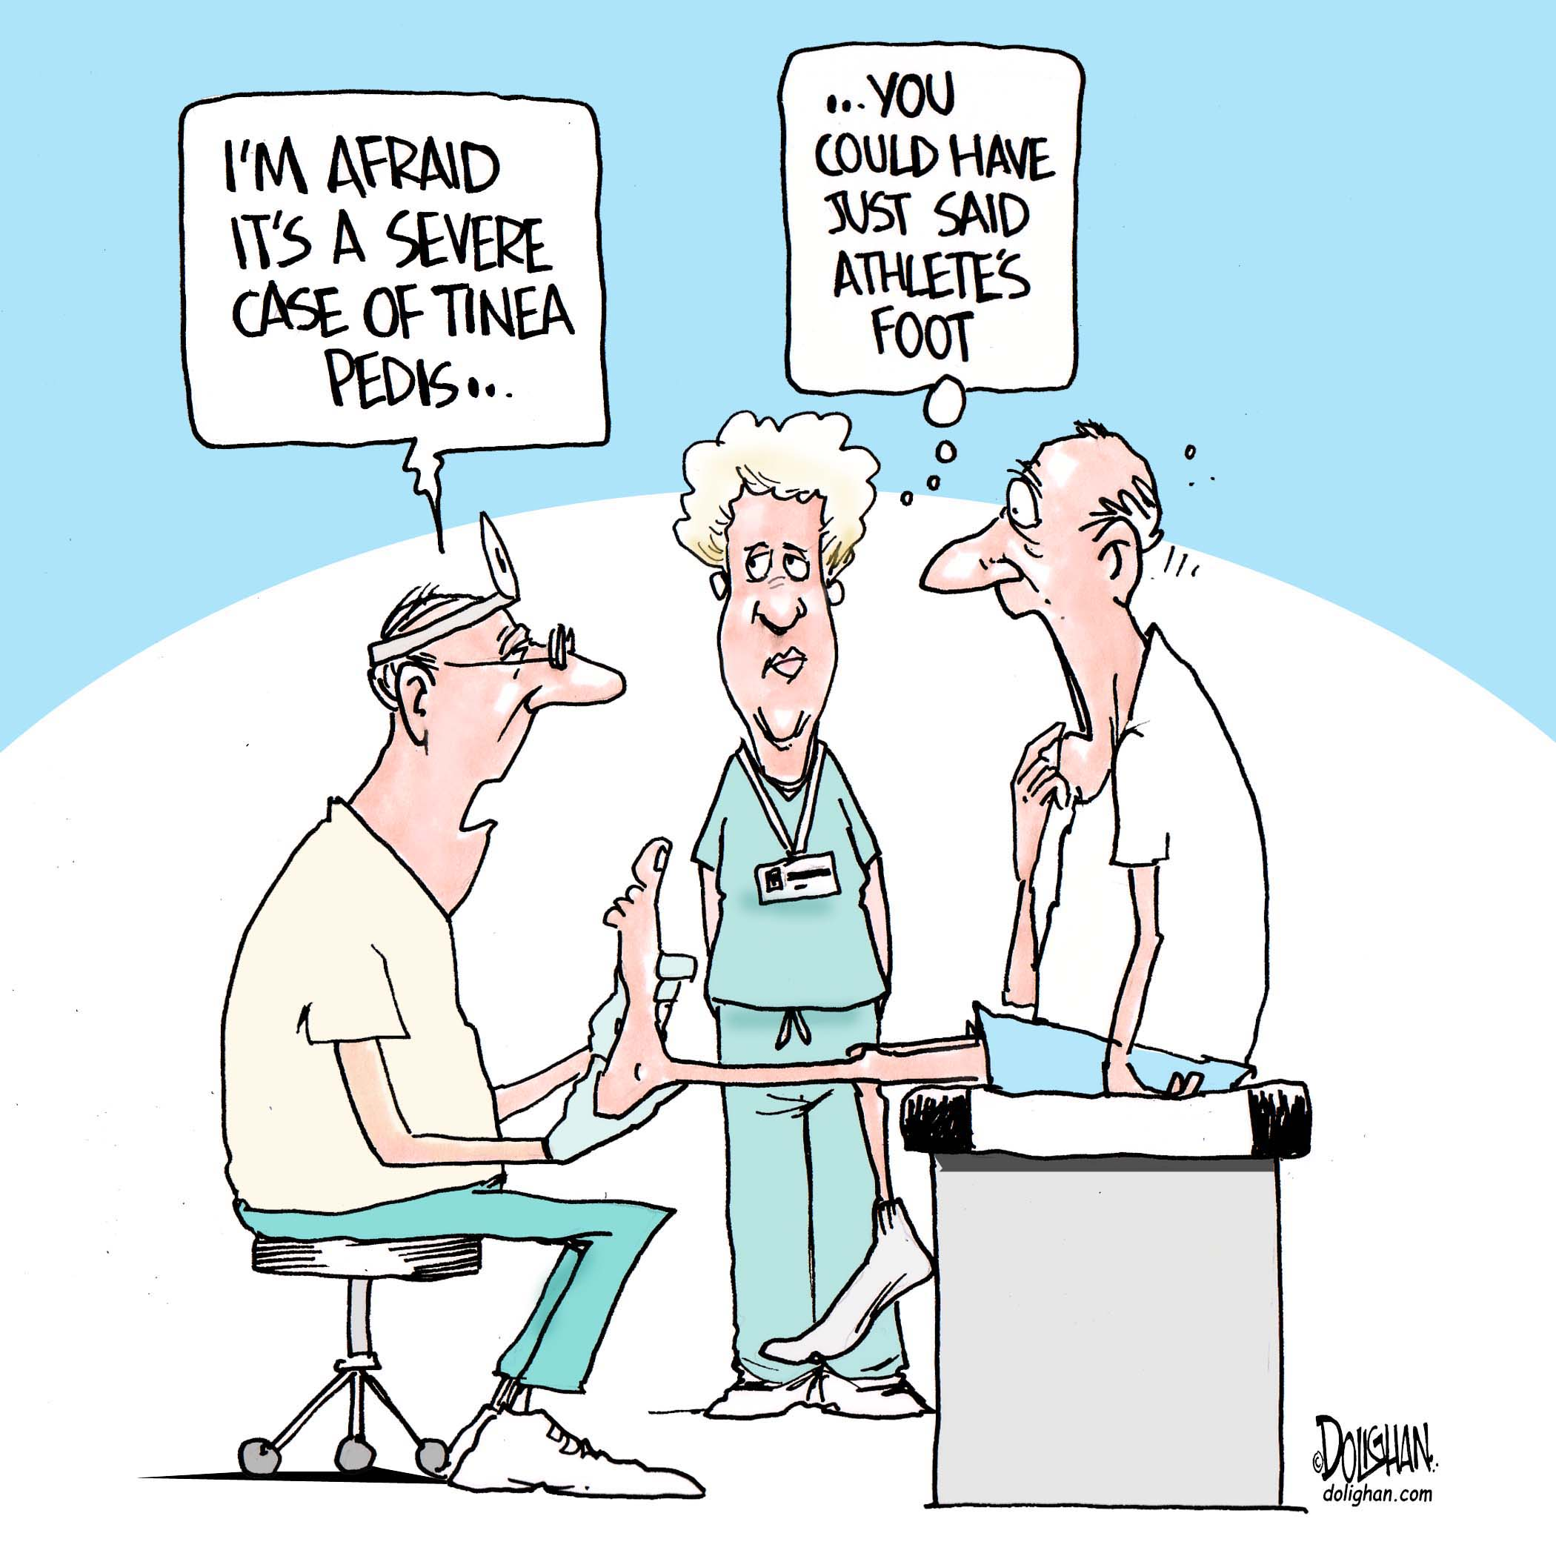

Slide 28

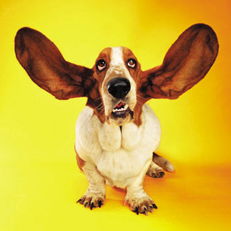

Slide 29
Get prepared
Physically attentive
Avoid stereotypes
Don’t jump to conclusions
Don’t interfere
Focus on the key points and underlying meaning
Write down
Maintain optimal eye contact
Give feedback and acknowledge agreement where appropriate
Paraphrase and clarify

Slide 30
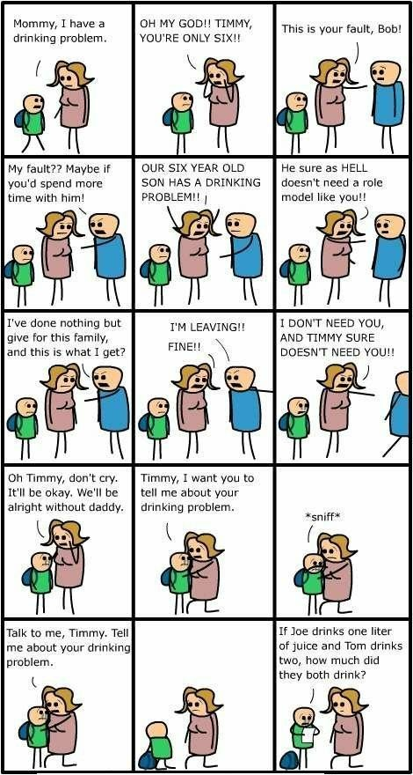

Slide 31

Giving positive feedback
Giving negative feedback
Receiving positive feedback
Receiving negative feedback

Slide 32

Positive feedback improves self-esteem
Be genuine
Be generous
Be direct

Slide 33

Managing the resistance
Focus on the issue rather than the person
Describe the issue rather being judgmental
Avoid ego clashes

Slide 34

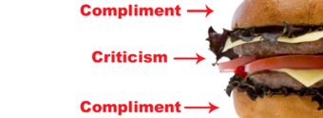

Slide 35

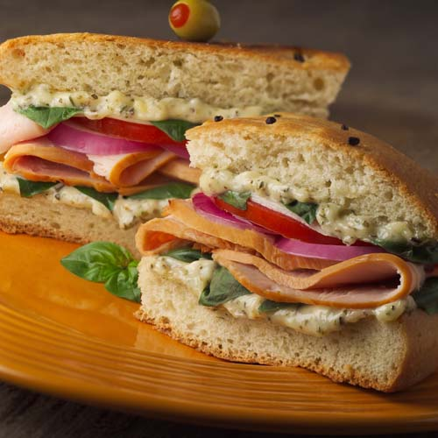
0
Ask
Tell
Ask

Slide 36

Starting the sentence with “I” rather than “You”
"I have noticed," "I have observed," "I have seen,“
Being assertive not aggressive
Focus on the instance not the person
Mention how the behaviour has affected you and others

Slide 37
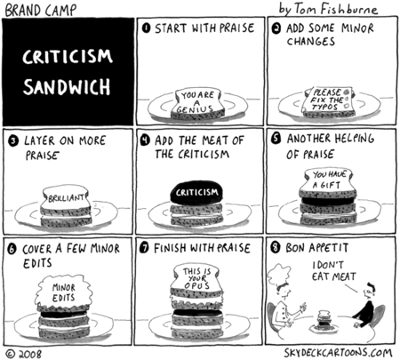

Slide 38

Accept the positive feedback
Learn from positive inputs
Thank

Slide 39

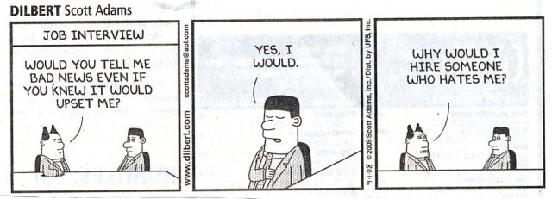

Slide 40
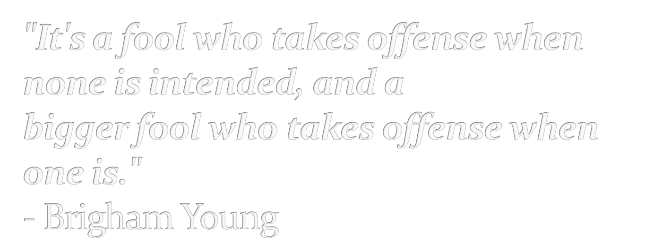

Slide 41
Acknowledge negative feelings
Introspect your feelings
Channel your emotional energy and choose a constructive response.
Overcome the fear of failure
Be positive

Slide 42

Attitude is a choice
Reactions are more important than actions
Focus on the content and don’t overreact
Try to learn even if it is poorly given
Evaluate the level of truth
Don’t take it too personally
Nobody is perfect

Slide 43

Social capital and human capital
Understand your values
Understand your strengths and weaknesses
Give your best
Be open
Be genuine
Show interest in people
Reciprocate help
Share information
Be in touch

Slide 44



